Slide 1
DIGITAL SYSTEM DESIGN
Text Book:
Stephen Brown and Zvonko Vranesic, Fundamentals of Digital Logic with Verilog Design (3e), Tata McGraw Hill 2014.
The slides in this document are prepared using the above text book

Slide 2
For contact,
Email: jyothi.k@manipal.edu
Mobile: 9008514218

Slide 3
Variables and Functions

Slide 5
We say that
L(x) = x is a logic function and that x is an input variable.

Slide 6
L(x1, x2) = x1 · x2
where L = 1 if x1 = 1 and x2 = 1,
L = 0 otherwise.
The “·” symbol is called the AND operator, and the circuit in Figure (a) is said to implement
a logical AND function.
L(x1, x2) = x1 + x2
where L = 1 if x1 = 1 or x2 = 1 or if x1 = x2 = 1,
L = 0 if x1 = x2 = 0.
The + symbol is called the OR operator, and the circuit in Figure 2.3b is said to implement
a logical OR function.

Slide 7
L(x1, x2, x3) = (x1 + x2) · x3
L(x) = x’

Slide 8
The complement operation can be applied to a single variable or to more complex operations.
For example, if
f (x1, x2) = x1 + x2
then the complement of f is
f’(x1, x2) = (x1 + x2)’

Slide 9
Truth Tables
x | x’
0 | 1
1 | 0

Slide 10
AND gate gives high output if and only if all of its inputs are high
OR gate output is LOW if and only if all of its inputs are LOW.

Slide 11
A | B | Q
0 | 0 | 1
0 | 1 | 1
1 | 0 | 1
1 | 1 | 0
A | B | Q
0 | 0 | 1
0 | 1 | 0
1 | 0 | 0
1 | 1 | 0
NAND
NOR

Slide 12
NAND gate gives LOW output if and only if all of its inputs are HIGH
NOR gate output is HIGH if and only if all of its inputs are LOW.

Slide 13
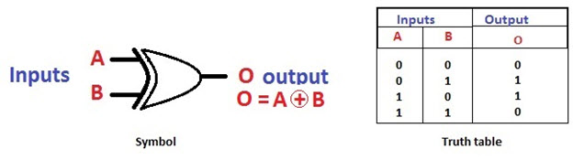
Exclusive OR (XOR)
XOR gate output is HIGH if it has odd number of HIGH inputs.

Slide 14
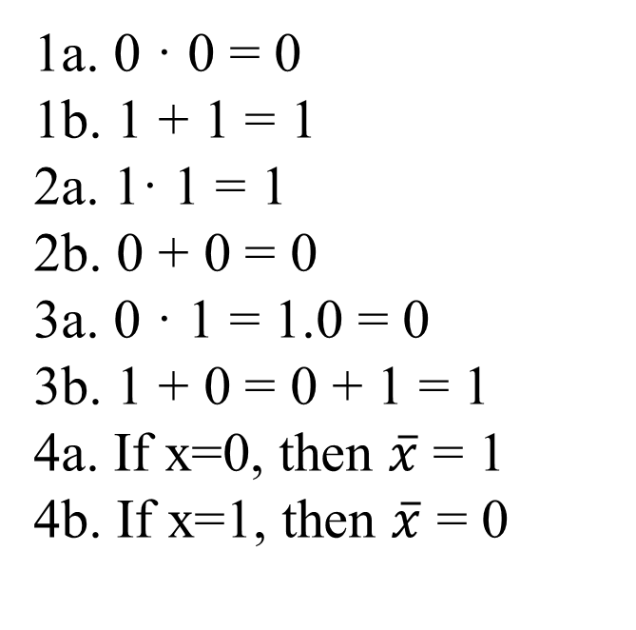
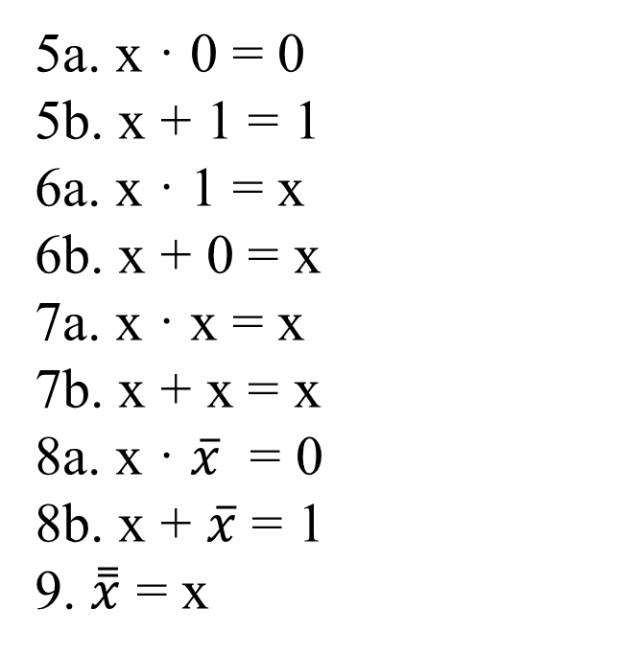
Boolean Algebra
Axioms
Single-Variable Theorems
1a. 0 · 0 = 0
1b. 1 + 1 = 1
2a. 1· 1 = 1
2b. 0 + 0 = 0
3a. 0 · 1 = 1.0 = 0
3b. 1 + 0 = 0 + 1 = 1
4a. If x=0, then $\overline{x}$ = 1
4b. If x=1, then $\overline{x}$ = 0
5a. x · 0 = 0
5b. x + 1 = 1
6a. x · 1 = x
6b. x + 0 = x
7a. x · x = x
7b. x + x = x
8a. x · $\overline{x}$ = 0
8b. x + $\overline{x}$ = 1
9. $\overset{̿}{x}$ = x

Slide 15
Duality
Given a logic expression, its dual is obtained by replacing all + operators with · operators, and vice versa, and by replacing all 0s with 1s, and vice versa.
The dual of any true statement in Boolean algebra is also a true statement.

Slide 16
Two- and Three-Variable Properties

Slide 18
Precedence of Operations
In the absence of parantheses, operation in a logic expression must be performed in the order: NOT, AND and OR.
Given f=a.b+a’.b’
first, a’ and b’ are calculated, then ab and a’b’ and finally ab+a’b’

Slide 19
Qn: Prove the validity of the logic equation
Solution:
(distributive property)

Slide 20
which is the same as the right-hand side of the initial equation.

Slide 21
Qn: Prove the validity of the logic equation
(x + x’ = 1)

Slide 22
(x + x’y = x + y)

Slide 23
Sum-of-Products and Product-of-Sums Forms
If a function f is specified in the form of a truth table, then an expression that realizes f can be obtained by considering either the rows in the table for which f = 1, or by considering the rows for which f = 0.

Slide 24
Minterms
For a function of n variables, a product term in which each of the n variables appears once, either in uncomplemented or complemented form is called a minterm.
For a given row of the truth table, the minterm is formed by including xi if xi = 1 and by including xi’ if xi = 0.

Slide 26
Sum-of-Products Form
Any function f can be represented by a sum of minterms that correspond to the rows in the truth table for which f = 1.
Example:
f

Slide 27
A logic expression consisting of product (AND) terms that are summed (ORed) is said to be in the sum-of products (SOP) form. If each product term is a minterm, then the expression is called a canonical sum-of-products for the function f

Slide 28
Example2:

Slide 29
This is the minimum-cost sum-of-products expression for f

Slide 30
The cost of a logic circuit is the total number of gates plus the total number of inputs to all gates in the circuit.
The cost of the previous network is 13, because there are five gates and eight inputs to the gates.

Slide 31
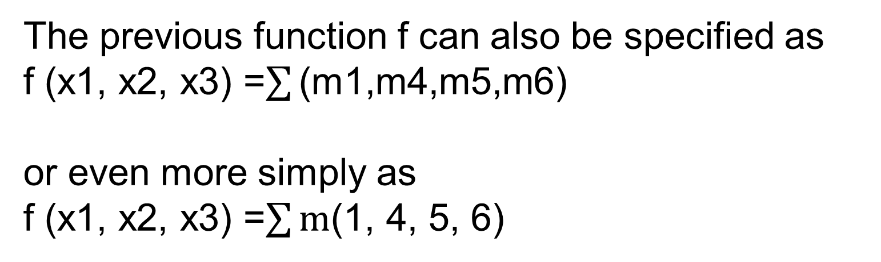
The previous function f can also be specified as
f (x1, x2, x3) =$\sum{\text{(}\text{m}\text{1,}\text{m}\text{4,}\text{m}\text{5,}\text{m}\text{6)}}$
or even more simply as
f (x1, x2, x3) =$\sum{\text{m}\text{(}\text{1, 4, 5, 6}\text{)}}$
Qn1: Simplify
f (x1, x2, x3) = m(2, 3, 4, 6, 7)

Slide 33
Qn2: Simplify
f (x1, x2, x3, x4) = m(3, 7, 9, 12, 13, 14, 15)

Slide 34
Maxterms
The principle of duality suggests that if it is possible to synthesize a function f by considering the rows in the truth table for which f = 1, then it should also be possible to synthesize f by considering the rows for which f = 0.
This alternative approach uses the complements of minterms, which are called maxterms.

Slide 36
Product-of-Sums Form
If a given function f is specified by a truth table, then its complement f’ can be represented by a sum of minterms for which f’ = 1, which are the rows where f = 0.
Example:

Slide 37
If we complement this expression using DeMorgan’s theorem, the result is

Slide 38
Example2:

Slide 39
Then f can be expressed as

Slide 40
A logic expression consisting of sum (OR) terms that are the factors of a logical product
(AND) is said to be of the product-of-sums (POS) form.
If each sum term is a maxterm, then the expression is called a canonical product-of-sums for the given function.

Slide 41
f
Using the commutative property and the associative property,
(using (x + y) (x + y’) = x)
The cost of this network is 13.

Slide 42
An alternative way of specifying our sample function is
or more simply

Slide 44
f
(using (x + y) (x + y’) = x)

Slide 45
Another way of deriving this product-of-sums expression is to use the sum-of-products form
of f’ . Thus,

Slide 46
→ SOP

Slide 47
Exercises:
1.
2.

Slide 48
f= x2’(x1 + x1’x3’) + x3(x1+x1’x2)
= x2’(x1 +x3’) + x3(x1+x2) (Using x+x’y = x + y)
= x1x2’ +x2’x3’ +x1x3 + x2x3
= x2’x3’ + x2x3 + x1x2’
or
=x2x3 + x1x3 + x2’x3’
(Using xy + yz + x’z = xy + x’z)

Slide 49
3.
(x1+x2) (x2’+x3)

